Slide 1
KSensor
KSensor
- APM2-
Ubicomp Lab
Soonchunhyang University

Slide 2
Index
APM2
APM2 Server Configuration Diagram
Description of each CNT addendum
Example code
Other information

Slide 3
APM2

Slide 4
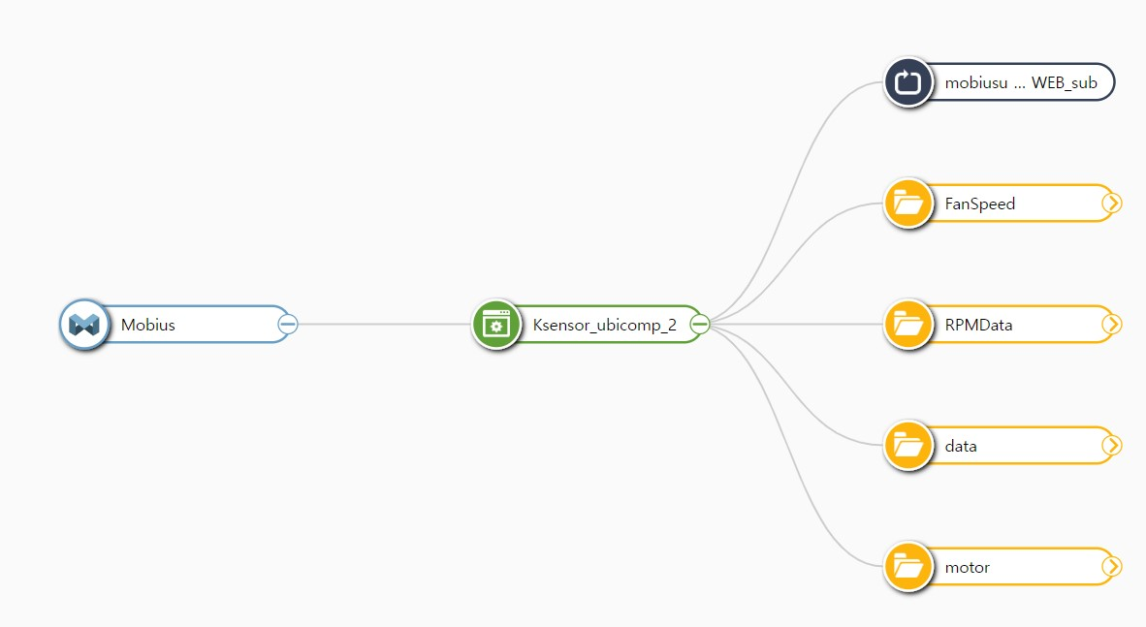
APM2 Server Configuration Diagram
APM2 Server Configuration Diagram

Slide 5
APM2 Server Configuration Diagram
Mobius
Ksensor…
(AE)
FanSpeed
(CNT)
This is where the current fan speed goes up.
ex) M1_P1_900
The red-bordered CNTs are the MQTT Brokers.
This means that you can send values to these CNTs and they will respond and get the values in real time.
Initially, all Fan Speeds have a default value of 900.
This is where the value of RPM goes up.
ex) 20240831110623, 33.7, 51.4, 54, 71, 46, 40
RPMData
(CNT)
This is where the data from APM2 comes from.
ex) 20240831093531, 37, 32,900,900,900,900,900,900,900,900,900,32,15,15,10,12,18,16,13,10,15,34.80,51.50,0.052,0.000,0.015,0.000,98.21,0.58
data
(CNT)
motor
(CNT)
This is where the user's commands are located.
ex) M1_P2_900

Slide 6
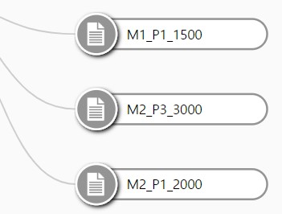
Fan Speed
FanSpeed
(CNT)
When the Arduino Mega recognizes the Mx_Py_z we put on the motor and rotates the yth fan in the x-box by z, the Arduino Mega will put the value of the current fan speed in FanSpeed(CNT).
RPMData
(CNT)
data
(CNT)
motor
(CNT)

Slide 7
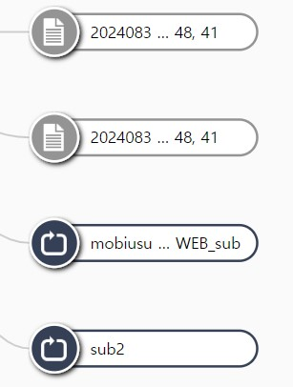
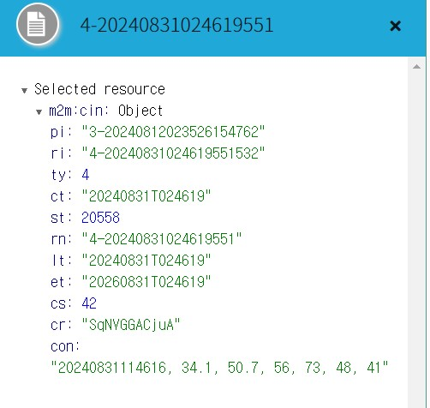
RPMData
RPMData(CNT) receives data from our reference machine RPM and stores it here.
It also acts as an MQTT broker. (sending the start signal to the Arduino Mega)
When the data from the RPM comes here, it parses the data from the Jetson Nano, which is submitting it, and stores it in a variable with the Datatime, the value before PM2.5 correction, and the value after PM2.5 correction. (Later, it will be combined with the data from the Arduino Mega and put the value in data(CNT).
FanSpeed
(CNT)
RPMData
(CNT)
data
(CNT)
motor
(CNT)

Slide 8
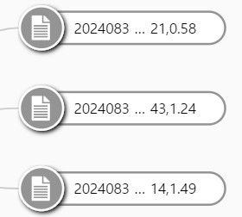
data
Data(CNT) is where all the values from the Arduino Mega and RPM are added together and put into the data format we want.
The format is Datetime, rpm before correction, rpm after correction, pwm1_1, pwm1_2, pwm1_3, pwm2_1, pwm2_2, pwm2_3, pwm3_1, pwm3_2, pwm3_3, npm, pm1_1, pm1_2, pm1_3, pm2_1, pm2_2, pm2_3, pm3_1, pm3_2, pm3_3, temp, humi, o3, co, no2, so2, wind_direction, wind_speed.
FanSpeed
(CNT)
RPMData
(CNT)
data
(CNT)
motor
(CNT)

Slide 9
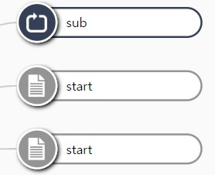
motor
FanSpeed
(CNT)
The example code (Fan Speed control code) motor(CNT) is where we put the commands we send. It also acts as an MQTT broker. (Sending Mx_Py_z to Arduino Mega)Here we can send commands in the form of Mx_Py_z.ex) M3_P2_3420
Note: z should only send 900, 1200, 1650, 2100, 2550, 3060, 3420.
This is also where the start signal comes in automatically, so don't panic if you see a start command.
RPMData
(CNT)
data
(CNT)
motor
(CNT)

Slide 10
Example Code (Fan Speed Control Code)
import requests
url = http://114.71.220.59:2021/Mobius/Ksensor_ubicomp_2/motor
headers = { 'Accept': 'application/json', 'X-M2M-RI': '12345', 'X-M2M-Origin': ‘SKsneosr_ubicomp_2', 'Content-Type': 'application/vnd.onem2m-res+json; ty=4’ }
data = { "m2m:cin": { "con" : "M1_P1_2000" } }
r = requests.post(url, headers = headers, json = data)

Slide 11
Example code (most recently posted code to get data)
import requests
url = http://114.71.220.59:2021/Mobius/Ksensor_ubicomp_2/data/la
headers = {
'Accept': 'application/json',
'X-M2M-RI': '12345',
'X-M2M-Origin': Skensor_ubicomp_2',
'Content-Type': 'application/vnd.onem2m-res+json; ty=4'
}
r = requests.get(url, headers = headers)
try:
r.raise_for_status()
jr = r.json()
print(jr["m2m:cin"]["con"])
except Exception as exc:
print("There was a problem : %s".format(exc))

Slide 12
이외의 정보들
When are RPM values uploaded?
RPM values are automatically uploaded periodically, every minute. (This is not an exact minute, sometimes there is a delay of a few seconds.)
Can I use a different fan speed than the one I specified?
Yes, you can. If you want a different speed than the 7 described, please contact me.
I want to know the Mobius monitor address
http://114.71.220.59:7575/#!/monitor
If you have any more questions, please contact me via Slack.

Slide 13
Q&A
Thank you
Questions?
Contact: kksp98y142@gmail.com

